Slide 1
EECS 498 System Design of a Search Engine
Winter 2026
Lab 2: Introduction
GSI: Christopher Davis
IA: Rickey Dong
Nicole Hamilton
https://web.eecs.umich.edu/~nham/
nham@umich.edu

Slide 2
agenda
Introduction / announcements
New assignments
Speed dating
Voting

Slide 3
agenda
Introduction / announcements
New assignments
Speed dating
Voting

Slide 4
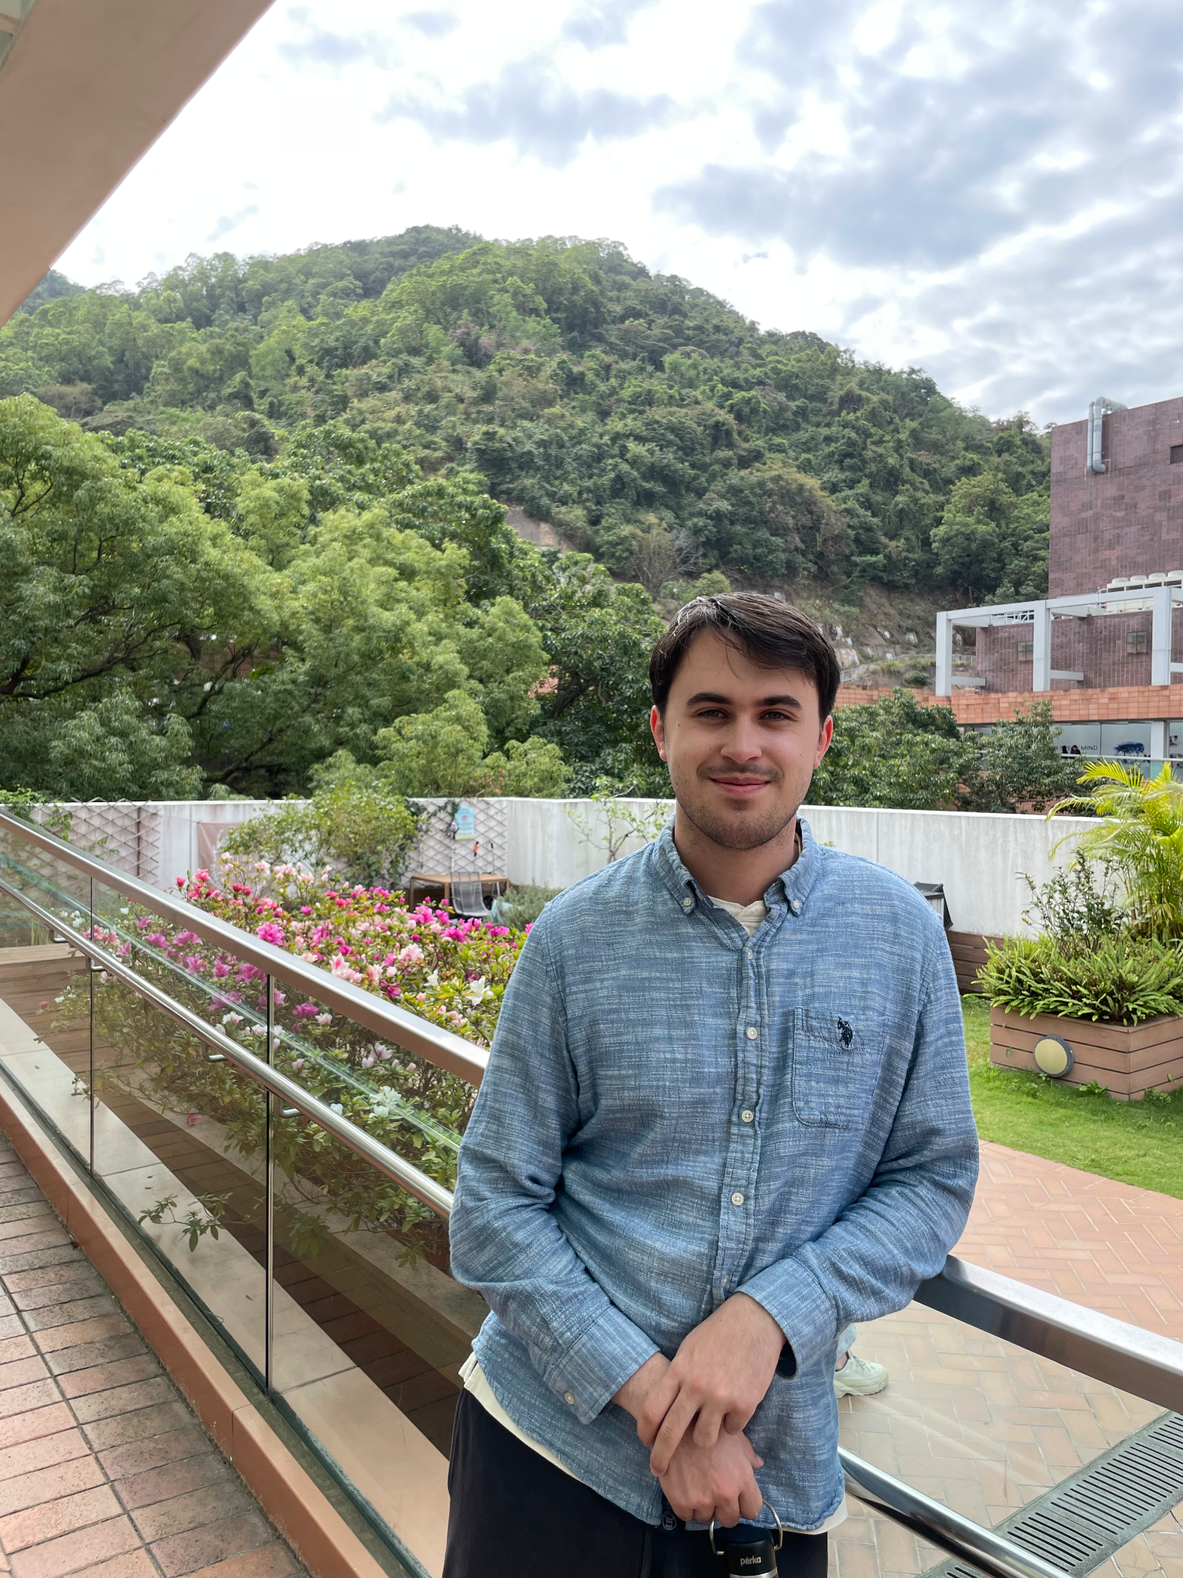
About Me
MS CS SUGS student (2026)
BS CS + Honors Math (2025)
Took this course in W25
Worked for Google Scholar
  Focused on ranking, but also some indexing and front-end. Maybe more on this when we get to ranking.
  Updating codebase to C++20
Christopher Davis
chcdavis@umich.edu

Slide 5
Office Hours
Chris:
Tues/Thurs 12:30-2:30 BBB Atrium (pending room assignment)
By appointment (virtually) most other times M-F.
Just email chcdavis@umich.edu with EECS498W26 in title.
Rickey:
Mon 3:30-4:30 (1637 BBB Table #1)
Wed 2:30-4:00 (1270A Leinweber)

Slide 6
agenda
Introduction / announcements
New assignments
Speed dating
Voting

Slide 7
New Assignments
Good job on the first homework!

Slide 8
New Assignments
Good job on the first homework!
There are two new autograder assignments out.
  Well, technically three

Slide 9
New Assignments
Good job on the first homework!
There are two new autograder assignments out.
  Well, technically three
UTF-8
  Encode and decode UTF-8 characters
  Notorious and difficult (and common) problem; lots of edge cases
  Lecture next week introducing, but should read up on the format early to get a general idea.

Slide 10
New Assignments
Good job on the first homework!
There are two new autograder assignments out.
  Well, technically three
UTF-8
  Encode and decode UTF-8 characters
  Notorious and difficult (and common) problem; lots of edge cases
  Lecture next week introducing, but should read up on the format early to get a general idea.
String/Vector
  Create your own well-optimized versions of RAII string/vector

Slide 11
Strings, Vectors, Etc.
Common complaint:
  “Why are we wasting time doing this? Wouldn’t we just use std::xyz in the real world?”

Slide 12
agenda
Introduction / announcements
New assignments
Speed dating
Voting

Slide 13
speed dating
First, how are we doing with team matching?
Reminder: should have teams formed by 18 January (Sunday)

Slide 14
speed dating
Today, we continue our speed-dating.
Break up in small groups of 3 or 4 for a short 5-to-10-minute discussion.
Collect some results.
Form new groups with people you haven’t met yet and repeat.

Slide 15
What would you like to know about someone to know if they’re a good match?
The -121 Section
Whether they drink Bubble Tea
Whether they are Performative
Motivation for success
Why they took the class
Good listeners
How interested they are
How much work they want
Whether the same pace
The -051 Section
How committed they are
Past experience on large projects
Working with people
Communication style
Track record on 281
Where do you live
How many extracurricular activities
Availability
Good chemistry
Expectations A or A+

Slide 16
We need a cartoon mascot for a class tee shirt. What animal should it be?
The -121 Section
Burmese Rescue Dog
Fat Squirrel
Eagle
C++ Mascot (a Rat)
Hawk
Spider
Lady bug
Octopus
The -051 Section
Road Runner
Panda
Cute spider
Raccoon
Owl
Cheetah
Mole peeking out of a hole
Golden retriever

Slide 17
Are there ways you might use AI ethically and productively in a class like this?
The -121 Section
Anything that doesn’t jeopardize own learning
Translating programs
Ask questions
What does this code do?
Generate testcases
Help with documentation
Explain concepts
Practice exams
Presentation slides
The -051 Section
Generate shell scripts / menial tasks
How to use Google Cloud Platform
Understand a concept
Refresh how to use a new language
Understand someone else’s code
Exam prep / example questions
Suggestions / ideas / progress
Brainstorming

Slide 18
How could you decide whether a link is worth crawling or a page is worth indexing?
The -121 Section
A link is worth crawling if it appears on lots of pages
Some Top level domains are better than others, .gov > .biz
Distance from the seed list
Authority and Hubs
Accessibility of the page
Avoid pages with ? parameters in the URL
The -051 Section
TLD .gov or .edu > .biz
Correct spelling
# of links pointing to the page
# of slashes in the URL
List of credible websites
Filetypes
Duplicate content
# of words in the title or on the page
Links in the middle of the text

Slide 19
When you look at search result, how do you decide whether it’s a good match?
The -121 Section
Lots of occurrences of the search words
Similar words on the page
Semantic similarity
Keywords in the title
Words near the top
<H1> vs <p>
Important words
The -051 Section
All the terms are on the page and in the title or near the top of the page
Length of page, longer CSS
Recent

Slide 20
When you look at search result, how do you decide whether it’s a good match?
The -121 Section
The -051 Section

Slide 21
If you distribute your engine across a lot of machines, should it have a master?
The -121 Section
The -051 Section

Slide 22
What do you think will be the hardest part of building the engine?
The -121 Section
The -051 Section

